Slide 1
The Necessity of Using School Leadership of Social Justice for the Inclusion of Refugee and Migrant Students in the Greek Schools
Argyro Rentzi
Preschool Teacher
c. Phd in the field of School Leadership of Social Justice (Alicante University)
Greek Ministry of Education and Religious Affairs

Slide 2
Statistical Description of the Refugee and Migrant Children Flows in the Mediterranean Area
Worldwide, at least 79.5 million people have been forced to flee their homes. That number includes about 26 million refugees. Almost half of them (40%) are children.
Between January and June 2020, 6,177 children arrived in Greece, Italy, Spain, Bulgaria, Cyprus and Malta. Of these, 2,302 (37%) were unaccompanied or separated children. Child arrivals in Greece, Italy, Bulgaria and Spain in the first half of 2020 decreased by 32% compared to the first half in 2019 (8,236).
Among the 3,033 accompanied children who arrived in Greece, Bulgaria and Malta between January and June 2020, 30% were 0 to 4 years old, 53% were 5 to 14 years old and 17% were 15 to 17 years old.
(UNCHR, 2020)

Slide 3
The situation in Greece
Between January and June 2020, some 3,340 children arrived in Greece by land and sea.
Like the number of people arriving overall in 2020 so far, the number of children also decreased, with 43% fewer children arriving than in the first half of 2019 (5,905). The number of children arriving unaccompanied or separated also decreased, with 61% less children compared to the same period in 2019 (994). Most children were from Afghanistan, the Syrian Arab Republic, the Democratic Republic of Congo, Iraq and State of Palestine.
(UNCHR, UNICEF & IOM, 2020).

Slide 4
The situation in Greece
Of all children present in Greece, 48% were living in urban areas (apartments, hotels, shelters for unaccompanied children, self-settled, etc.); 28% were in accommodation sites; 1% were in safe zones for unaccompanied children and 23% were in Reception and Identification Centers.
An estimated 45,100 children were present in Greece as of 30 June 2020, an increase from 32,000 in June 2019.
(UNCHR, UNICEF & IOM, 2020).

Slide 5
School Leadership of Social Justice
The 21st century has led to significant socio-cultural changes for many nations, due to the movement of populations, directly affecting the school environment, which seeks ways to adapt to this new reality.
The concept of “social justice” is chosen by scholars, because it is a broader one than the concepts of “equal opportunities” and “equality”, which makes it even more difficult to define (Michail, 2013). It is used to demonstrate the unifying factors, which support the general movement towards a fairer, less oppressive society (Griffiths, 1998).
The concept of social justice is used to support and link a more general movement to a fairer, less oppressive society through educational leadership, seeking ways to overcome inequality and improve the conditions of children’s success and access to education and other goods of public and private life (Griffiths, 2003).

Slide 6
Characteristics of the school leader of social justice
Social justice leaders act as advocates for traditionally marginalized and poor students and are committed to fighting inequality structures in economy, civilization and power (Jean – Marie, Normore & Brooks, 2009).
A key element, that distinguishes school leaders fighting for social justice, is: a) their deep and critical reflection on their experiences and fundamental values (Zembylas & Iasonos, 2016), b) the ways in which they intervene with a moral purpose (Shields, 2004) and c) their efforts to find alternative ways of explaining circumstances, showing solidarity (Shields, Laroque & Oberg, 2002).

Slide 7
Characteristics of the school leader of social justice
The social justice leader challenges inequalities in a number of ways: by creating a climate of belonging, by improving the academic performance of all students without exception, by improving the core teaching at school and curriculum and, finally, by promoting inclusion, access and opportunity for all children (Zembylas και Iasonos (2016).
However, in their effort to achieve the above, school leaders of social justice must have the ability to overcome the obstacles, through their ability to be adaptable to current condition. Besides, according to Cambron-McCabe (2006), the school leader of social justice is able to respond effectively to the current political, socio-economic, institutional and cultural school environment.

Slide 8
Characteristics of the school leader of social justice in a multicultural school
Bibliography on the field of social justice leadership in a multicultural school environment demonstrates the distinctive characteristics and inclusion practices that these school leaders follow, guided by the values of social justice and equality in their school communities (Theoharis, 2007, 2009; Zembylas & Iasonos, 2017).
Similarly, earlier, Walker’s (2005) findings agree that successful school principals are committed to enforcing values, which promote justice, equality and mutual respect.
Other research studies report that these school leaders engage in aggressive practices against social inequalities, particularly racism and poverty and are more provident in taking action towards this direction (Goddard, 2007 ∙ Leeman, 2007; Mahieu & Clycq, 2007).

Slide 9
Using school leadership of social justice to include refugee and migrant students in the Greek schools
The principal could call the Teachers Board for a meeting and discuss the following possible options for the school unit: a) creating a school culture, that accepts the equality of all people and rejects all kinds of discrimination (social, linguistic, religious, cultural nationality), b) the inclusion of educational specificities in the school educational programs, c) the creation of refugee integration programs for the families of the refugee children, in partnership with the School Board of Parents. d) opening the school to the local community so as to succeed the smooth integration of refugees and their families in the local society.
2. Creation of a multicultural school environment: By adopting a transformative leadership style and fostering teamwork and participation in decision-making, the school principal could encourage the teachers to attend multicultural education training programs, inside and outside the school unit. Furthermore, in these programs it would be good to involve the families of all pupils, plus the refugee families. The support of the school library with books, written in other international languages, besides the Greek one, would also be of great help.

Slide 10
Using school leadership of social justice to include refugee and migrant students in the Greek schools
Inclusion of educational particularities in the educational programs: It is important to create and promote innovative educational programs, based on multicultural educational material, which is developed under the auspices of the Council of Europe and other international institutions, such as UNESCO.
Teachers should realize that they should play the leading role in the cultural exchange process, developing and using strategies of understanding other cultures through education. They should encourage communication amongst pupils of all ethnic groups in order to create a pleasant learning environment, in which all of the children, depending on the cultural capital they bring with them, can develop their skills and interests
4. Creation of integration programs of refugee families / Opening the school to parents and community: it should be of primary importance for the school leadership to encourage personal relationships between children, teachers and their families in order to create teamwork dynamics and mutual acceptance.

Slide 11
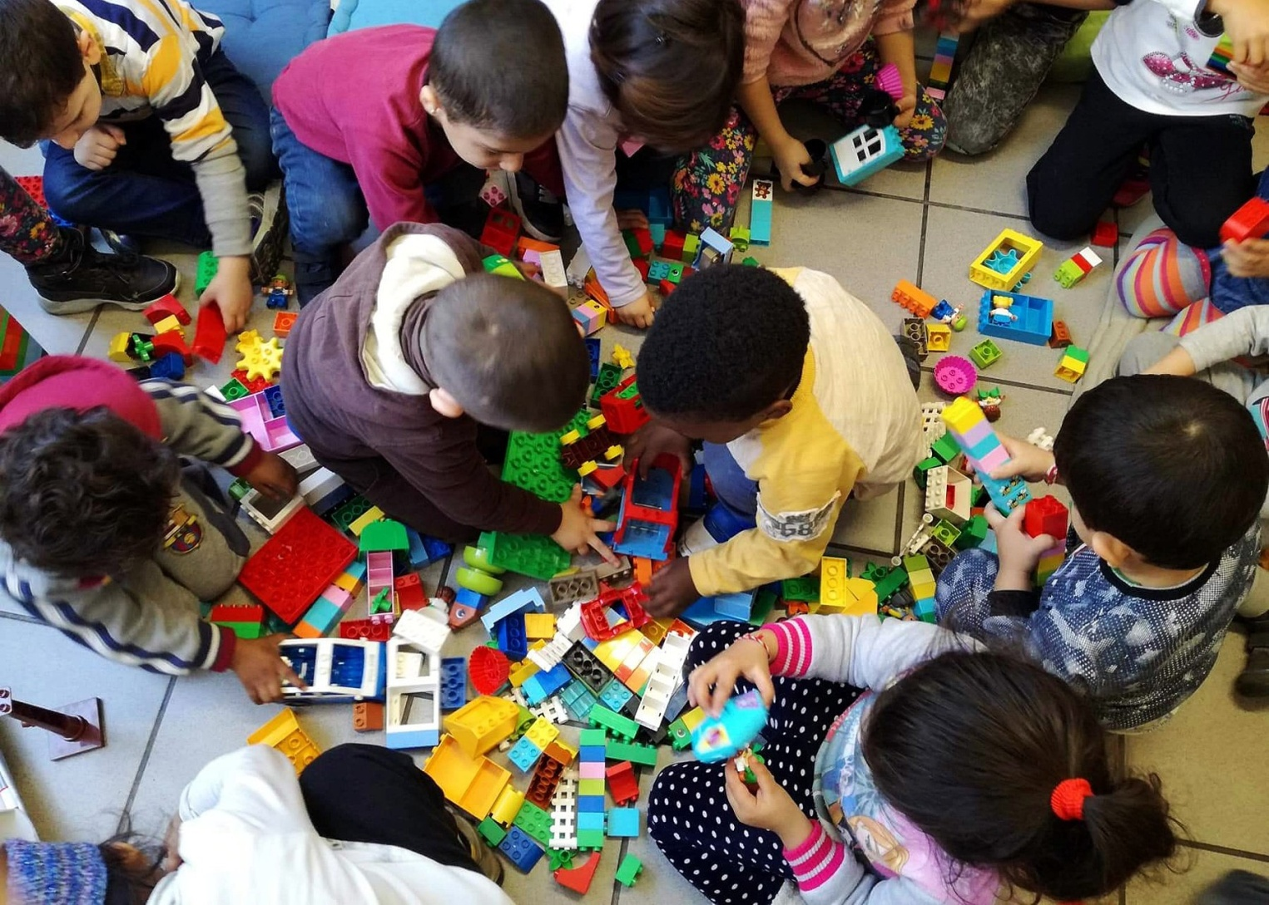
THANK YOU FOR LISTENING!

