Slide 1
Investigating Intercultural and Interreligious Values in Education Preparation Programs: A COIL Process During a Pandemic
June 3rd, 2021
Prof. Dina Sijamhodžić-Nadarević & Prof. Catherine Dunn Shiffman
Faculty of Islamic Studies Department of Leadership Studies
Sarajevo University Shenandoah University
Educational Leaders Without Borders Panel:
Hope and Fear: The Duality of the BIPOC Experience and the Fight for Equity

Slide 2
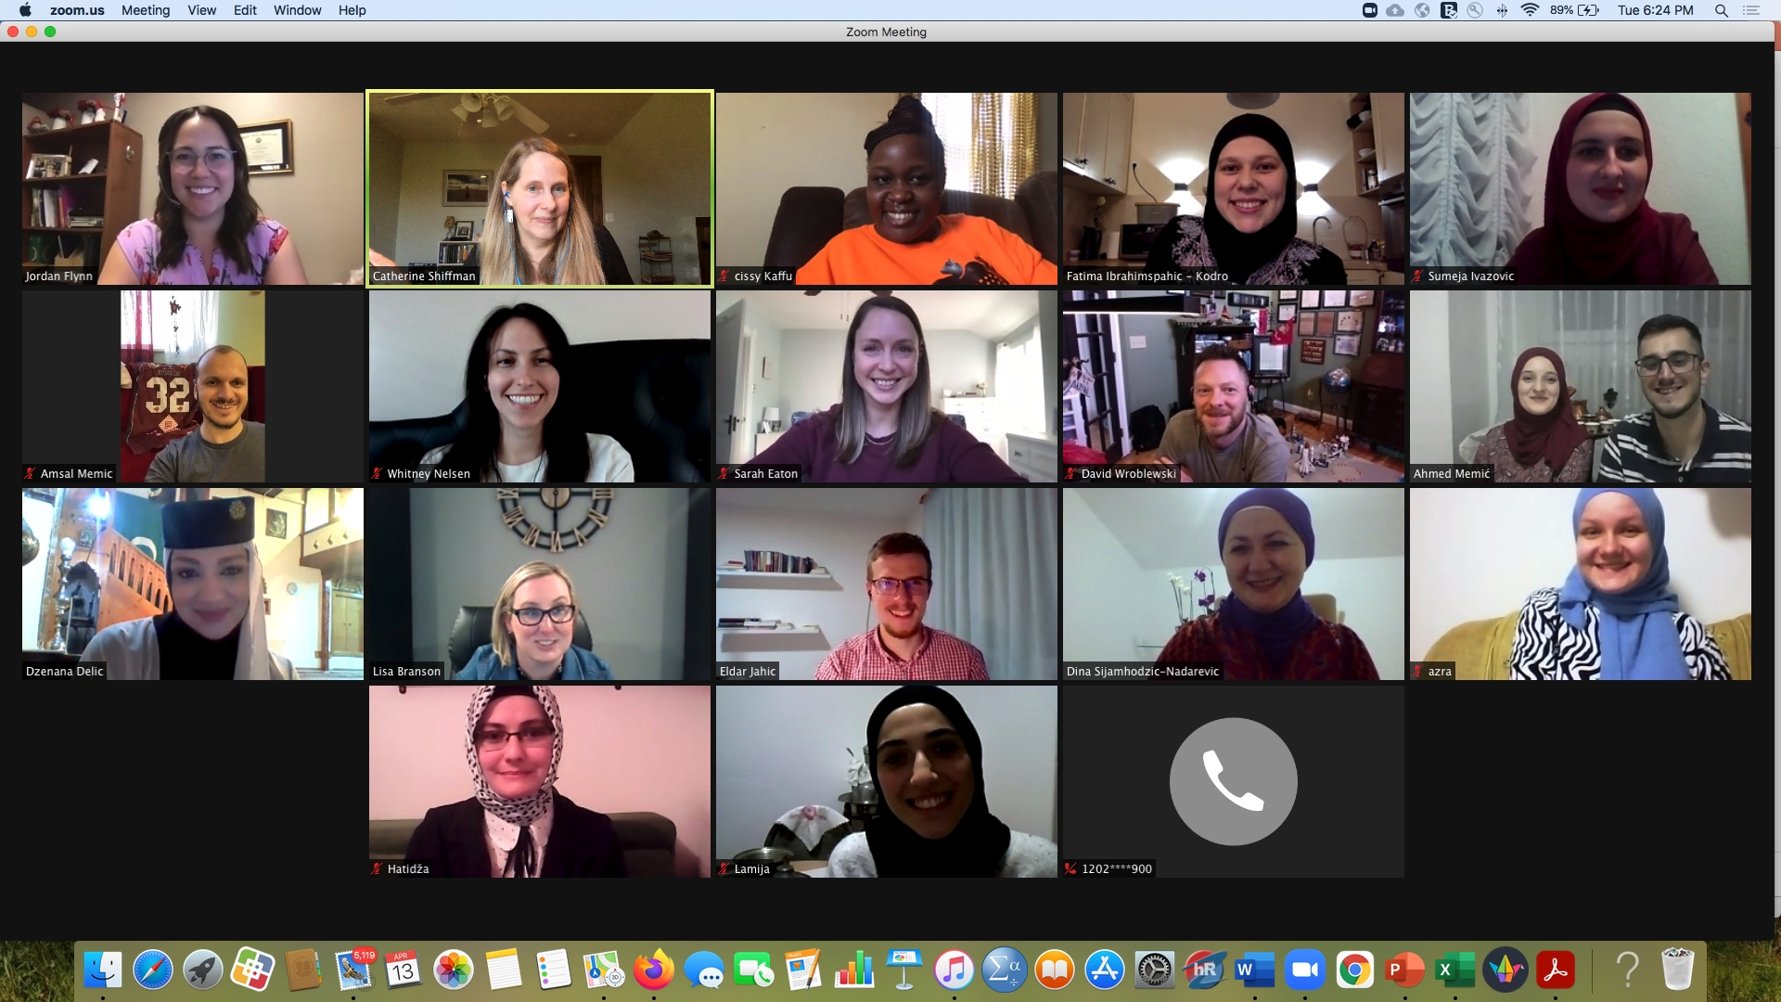
Preparing Teachers and Educational Leaders to Advocate for Equitable Outcomes in Education Systems and Organizations

Slide 3
Collaborative Online International Learning (COIL) Project
Sarajevo University
Shenandoah University
Course/Program
Course/Program
Faculty
Faculty
Students
Students
Collaboration between faculty and students for the purpose of shared learning
Aligned with shared teaching responsibilities and research interests in pedagogy and intercultural education.
Our Driving Question
How do university and college education programs in the U.S. and Bosnia & Herzegovina define and promote intercultural and interreligious values of equity, diversity, tolerance, and solidarity?

Slide 4
COIL Pilot Project Background
Barzinji Project: A partnership between higher education institutions in the U.S., Malaysia, and Bosnia & Herzegovina
Two phases in the COIL Pilot:
Phase I– COIL training for the faculty and staff from four universities
Phase II– Our COIL collaboration with students throughout two semesters

Slide 5
COIL Pilot Activities
Introductions and virtual communication (ZOOM; email, WhatsApp, Google Drive, Canvas, etc.)
Global teams of students
Analyze national/country and international legal and professional frameworks, and instruments with regard to intercultural education, policies, and initiatives.
Analyze and compare how intercultural values of equity, diversity, tolerance, solidarity and interreligious values are promoted in a university in the U.S. and in Bosnia & Herzegovina
Develop inclusive curricula, policy recommendations, and intercultural events.
Create presentations and videos
Debrief and reflect

Slide 6
Broader Context of the COIL Pilot
Faculty: A professional learning community
Students:
Develop intercultural competencies for future teachers and educational leaders
Encourage academic mobility, overcoming mobility barriers and presentation to wider community
Learn about different cultural, historical, religious, educational backgrounds
Apply to jobs in educational systems, higher education, organizations as a model for reaching equitable outcomes.

Slide 7
Thank you for your attention!
Dina Sijamhodžić-Nadarević, PhD, Associate Professor, University of Sarajevo. Email: dina.sijamhodzic-nadarevic@fin.unsa.ba
Catherine Dunn Shiffman, PhD, Professor, Shenandoah University. Email: cshiffma@su.edu;

